Slide 1

Olympics Data Analysis

Slide 2




Team - 10
Jefrina Jahangir Data Analyst
Venkata Sai Mohan Team Lead,
Data Scientist
Jitendra Prasad Data Engineer
Bikram Chand Data Cleaning

Slide 3
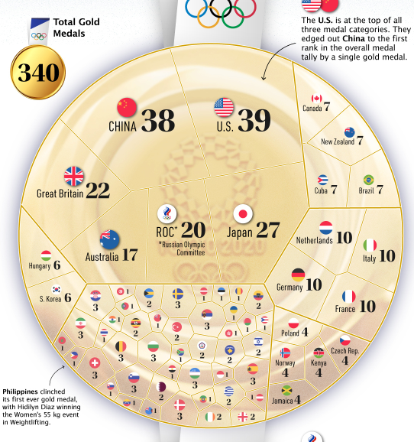
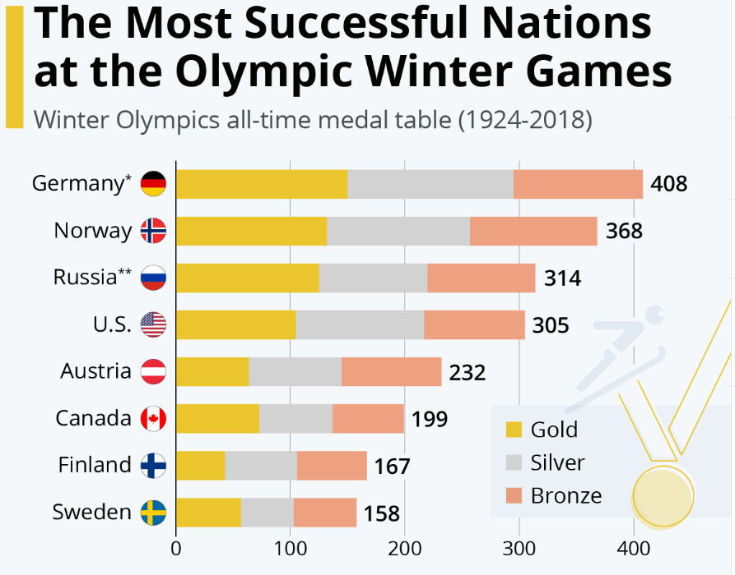
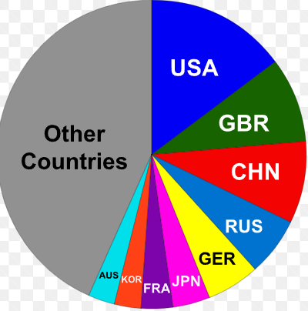
Business Question
"What is the optimal strategy for allocating sponsorship funds to Olympic teams, taking into account historical medal performance, current prospects, and potential for future success?"

Slide 4
The Solutions
Optimized Sponsorship Selection
Medal Clustering Analysis Based on Country Performances
Predictive Modeling
01
02
03

Slide 5
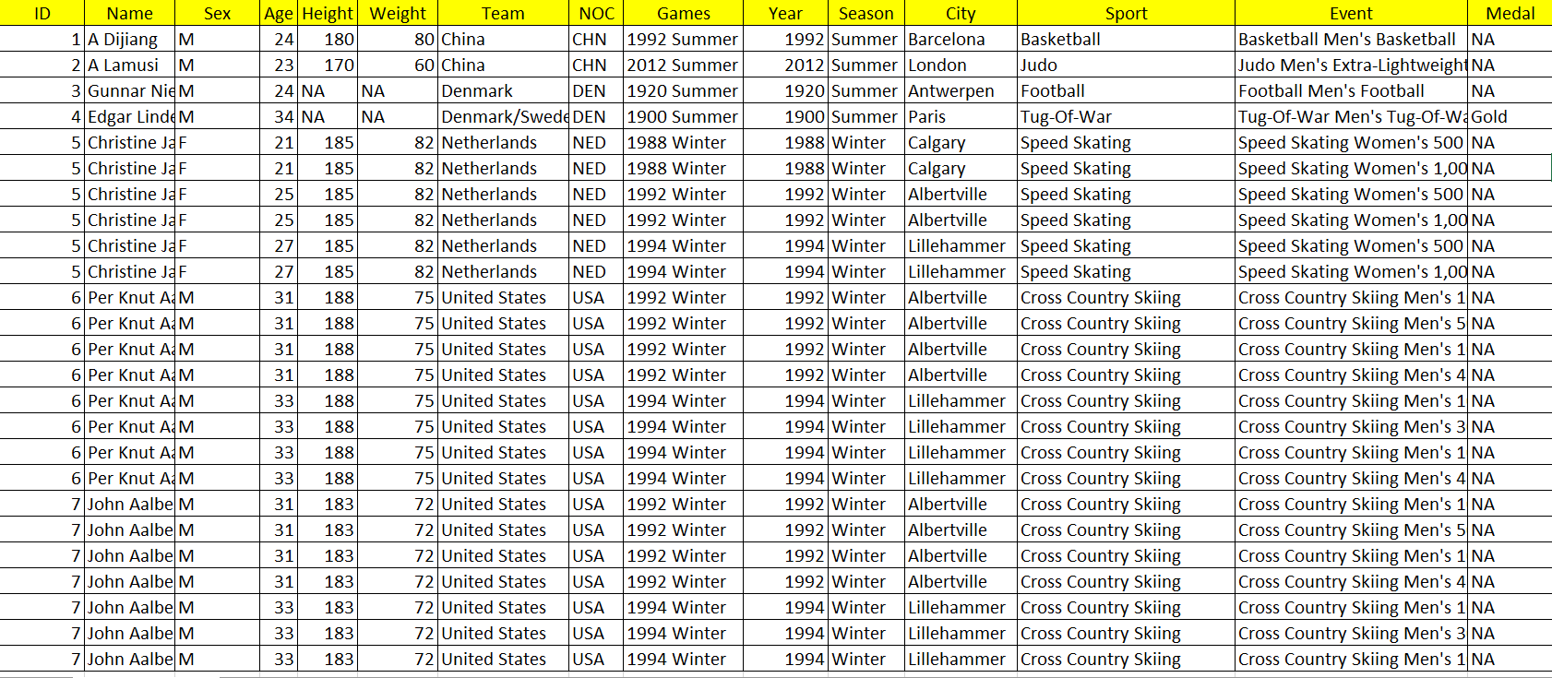
Data Overview
The dataset is collected from Kaggle.

Slide 6
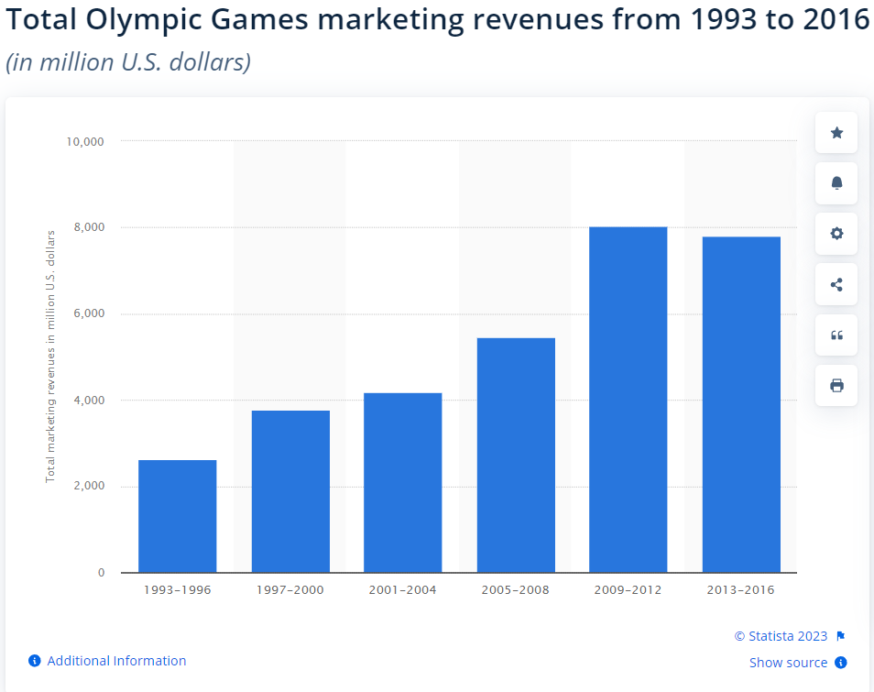
Total Market Size

Slide 7
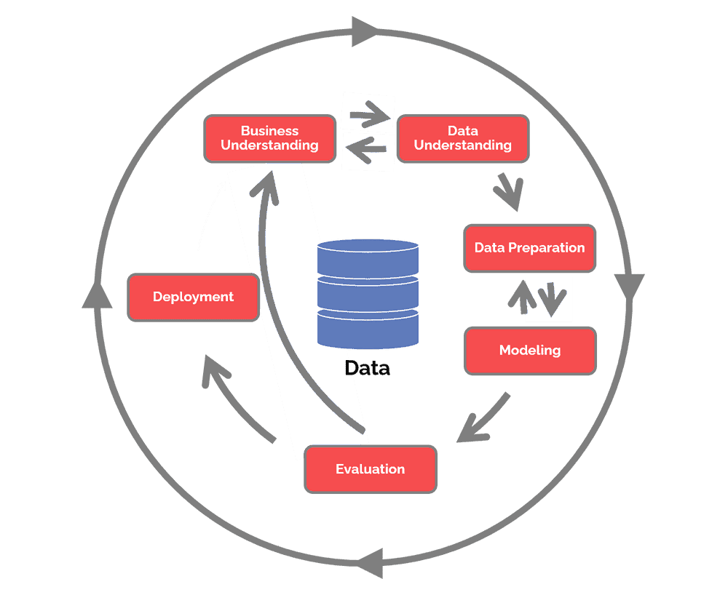
METHODOLOGY CRISP-DM

Slide 8
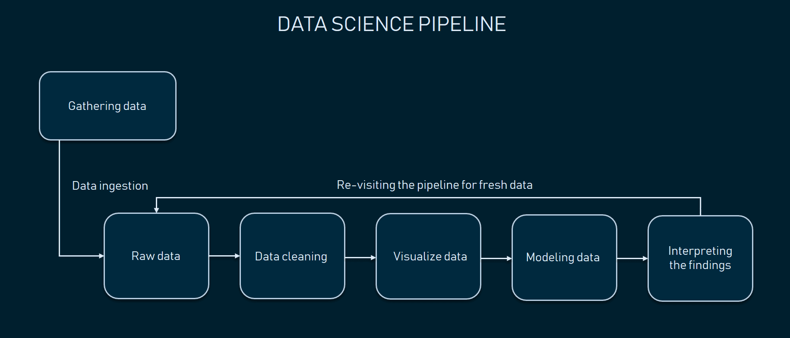
Project Pipeline

Slide 9






Technologies

Slide 10

References
1)https://www.visualcapitalist.com/olympic-medal-count-tokyo-2020/
2)https://www.datascience-pm.com/crisp-dm-2/
3)https://www.statista.com/chart/12770/olympic-winter-games-all-time-medal-table-countries/
4)https://images.app.goo.gl/6nVqTcLM5qzTYM8R6
5)https://images.app.goo.gl/RrVUTCaTkoSkSZtt8
6)https://images.app.goo.gl/mrfzc98AUXH42XhU8
7)https://images.app.goo.gl/Hti9uv8s3JpY35seA
8)https://images.app.goo.gl/8r8B8uJzaw8EydUz9

